Slide 1
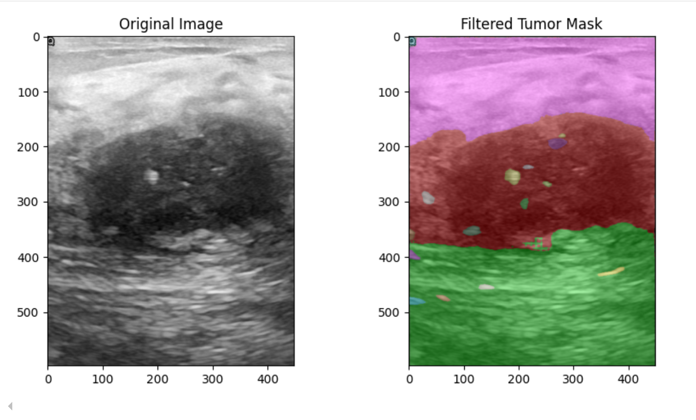
Automatic Segmentation

Slide 2
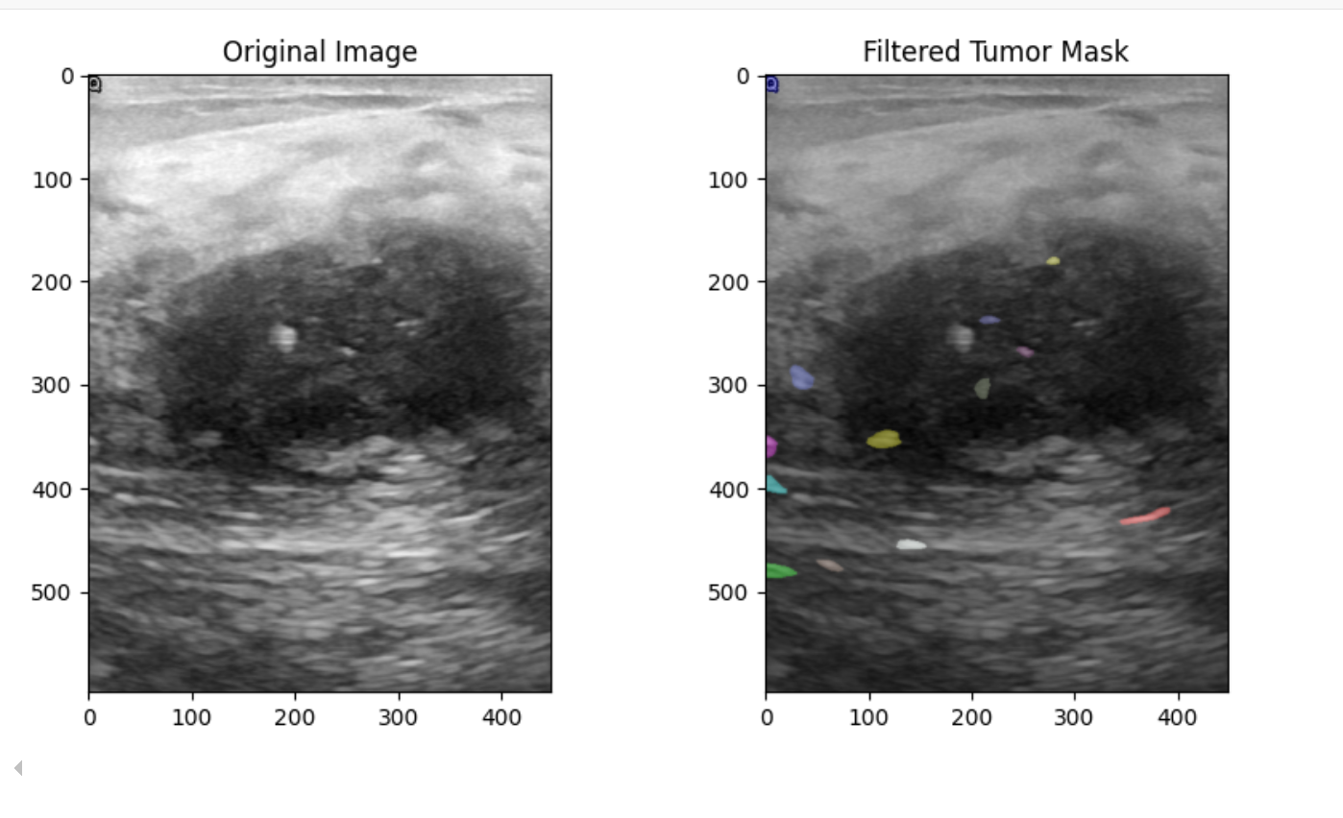
Automatic Segmentation with Filtering
Min: 0
Max: 500 px

Slide 3
Automatic Segmentation Filtering
Min: 0
Max: 500 px

Slide 4
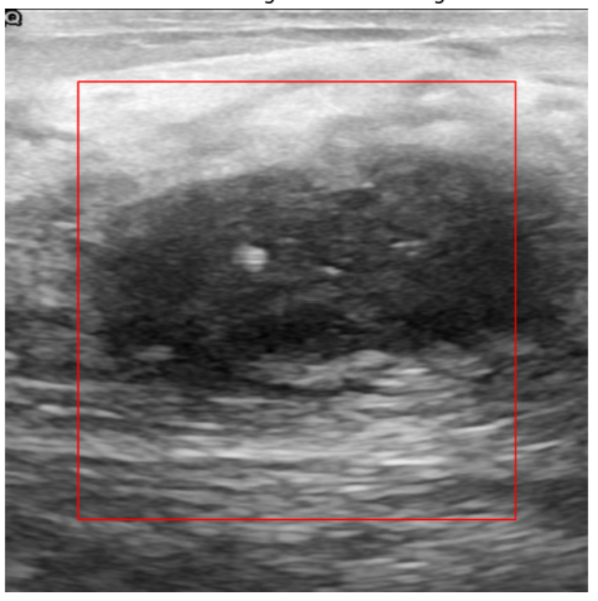
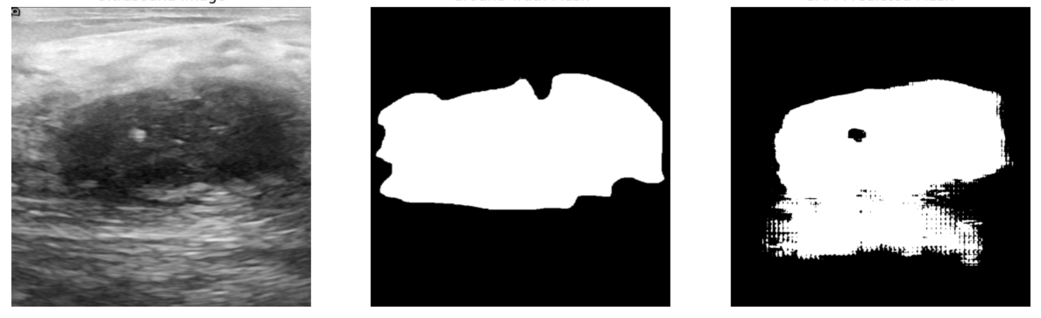
Bounding Box based on the 75% of the Image

Slide 5
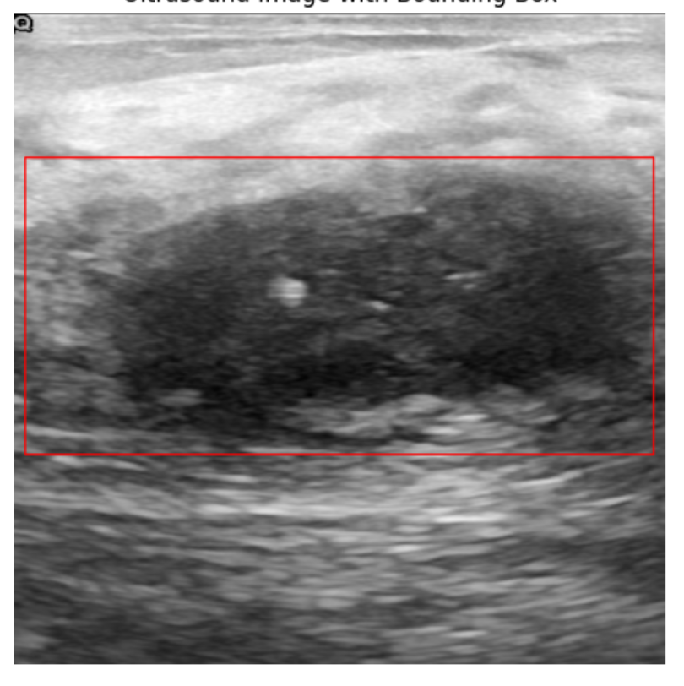
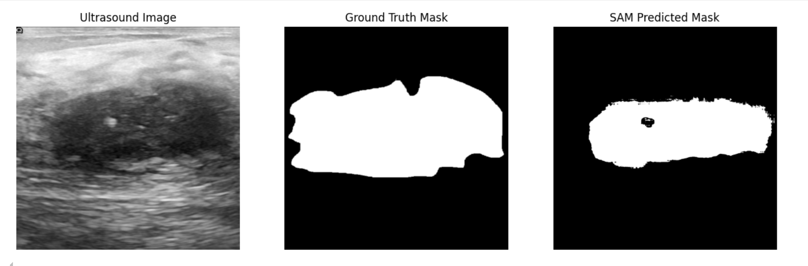
Bounding Box Generation from a Pre-Existing Professional Mask

Slide 6
Conclusion
Although SAM provides an automatic mask generation option, it may not be the most suitable for this problem. In this case, segmentation might detect too many small regions or even irrelevant elements, such as letters and noise.
Additionally, incorporating a bounding box, even if placed randomly, can improve the model's ability to detect tumors. A randomly generated bounding box can help limit the segmentation area and reduce the chances of detecting irrelevant regions. Moreover, if this process is assisted by a professional, or if an initial step is applied to define a more meaningful bounding region, the segmentation results can be significantly more accurate and reliable.

